Slide 1
KIDNEY STONE DETECTION
-USING MATLAB
Team Members
-Gaduputi Thanusree : 2004079
-Poluparti Supriya ;2004118
-Ganika Sarma :2004077s

Slide 2

INTRODUCTION
Kidney stones are a common health issue affecting millions of people worldwide. The presence of kidney stones can cause severe pain and discomfort and, if left untreated, can lead to serious health complications.
Early detection and treatment of kidney stones are crucial to managing this condition effectively. Medical imaging plays a vital role in the detection and diagnosis of kidney stones.

Slide 3
INTRODUCTION
However, manual analysis of medical images can be time-consuming and prone to errors. This project aims to develop a kidney stone detection system using MATLAB, a powerful tool for image processing and analysis.
The system will use various image processing techniques to automatically detect the presence of kidney stones in medical images, making it a cost-effective and non-invasive solution for medical professionals.

Slide 4
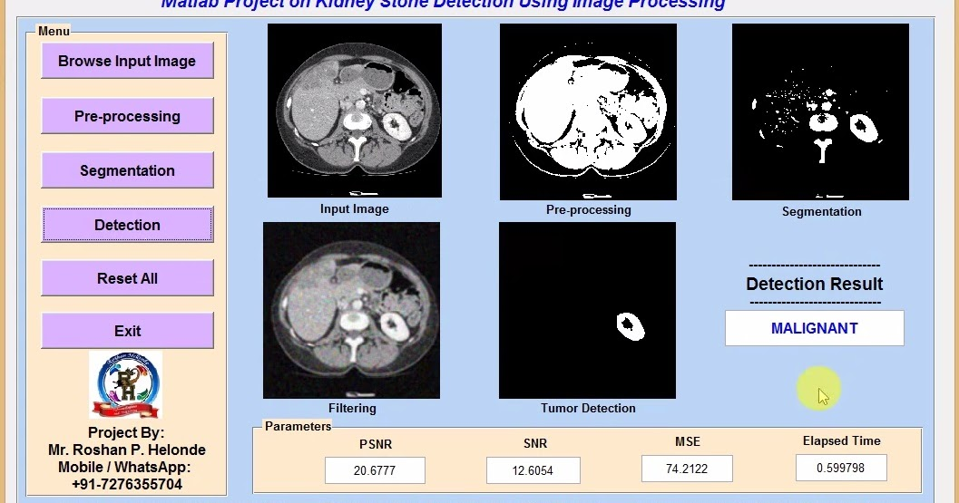
ABSTRACT
The presented MATLAB project implements a kidney stone detection system using image processing techniques.
The script involves a series of steps that preprocess the input image and apply thresholding and filtering techniques to detect the presence of kidney stones.
The resulting binary image is used to create a region of interest that is applied to the original image to isolate the suspected stone.

Slide 5
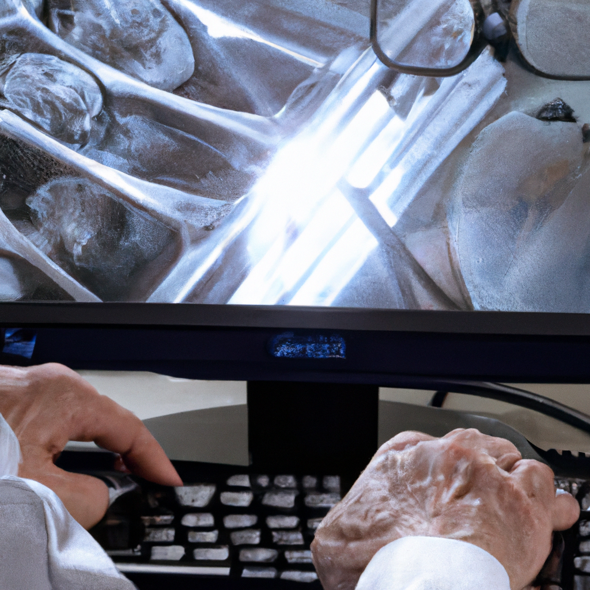
ABSTRACT
The system is designed to detect stones accurately and efficiently, making it a potentially valuable tool for medical professionals in the diagnosis and treatment of kidney stones.
Overall, the presented code demonstrates the power of image processing techniques in the field of medical imaging and the potential to develop cost-effective and non-invasive solutions to common medical problems.

Slide 6
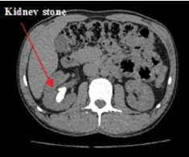
DATA USED
Medical imaging data, such as ultrasound or CT scans, is used for this type of project.
The data would typically consist of grayscale or colour images of the kidneys and surrounding areas, which would be processed using image processing techniques to detect the presence of stones.
The quality and quantity of the data used would play an important role in the accuracy and effectiveness of the kidney stone detection system.
Gray Scale image of kidney detecting stone

Slide 7
METHODOLOGY
DATA COLLECTION
The first step is to collect the medical imaging data that will be used to train and test the kidney stone detection system.
The data can be sourced from public repositories or collected through collaborations with medical institutions.
PREPROCESSING
The collected images need to be preprocessed before being used for kidney stone detection.
The preprocessing includes steps such as noise reduction, image enhancement, and image normalisation to improve the quality of the images.

Slide 8
METHODOLOGY
SEGMENTATION
The next step is to segment the preprocessed images into regions of interest (ROIs) that are likely to contain kidney stones.
This can be done using various image segmentation techniques such as thresholding, edge detection, and region growing.
FEATURE EXTRACTION
Once the ROIs have been identified, relevant features need to be extracted from the images to differentiate between kidney stones and non-stone regions.
These features can include the size, shape, texture, and intensity of the regions.

Slide 9
METHODOLOGY
CLASSIFICATION & TESTING
The extracted features are then used to classify the ROIs as either containing kidney stones or not.
The classification results need to be validated and tested to assess the accuracy and effectiveness of the kidney stone detection system.
DEPLOYMENT
Once the kidney stone detection system has been validated and tested, it can be deployed in clinical settings to aid medical professionals in the diagnosis and treatment of kidney stones.

Slide 10
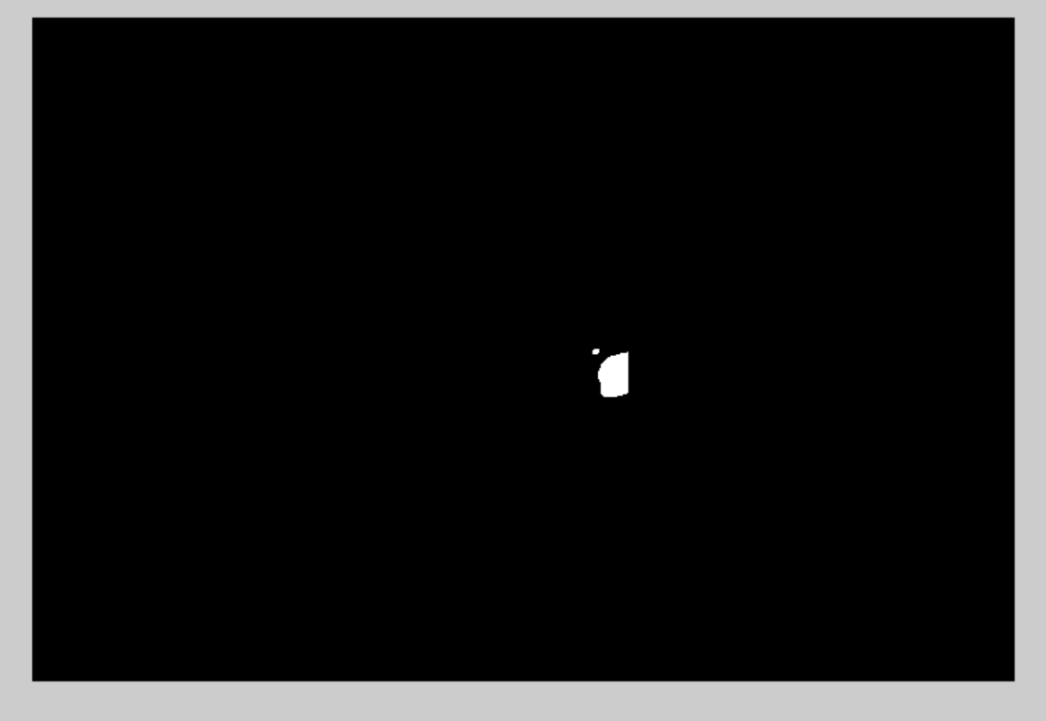

RESULTS
IMAGE WITH STONE
IMAGE WITHOUT STONE

Slide 11

Conclusion
In conclusion,kidney stone detection is an important area of medical research that has been greatly enhanced by the use of MATLAB. By applying advanced image analysis techniques and machine learning algorithms,researches can create more accurate and efficient methods for detecting kidney stone.With ongoing research and development, the future of kidney stone detection looks bright, offering hope for improved outcomes and quality of life for patients around the world.

Slide 12
Project link-https://github.com/Supriyagithub2308/KidneyStoneDetection
THANK YOU!

